Slide 1
Macro-Parametrics Approach for CAD Translation to X3D
Yuna Kang, Pranveer Singh Rathore, Soonhung Han
iCAD Lab
KAIST

Slide 2
Contents
Background
Macro-Parametrics Approach (MPA)
X3D Translator
Experiments
Conclusion

Slide 3
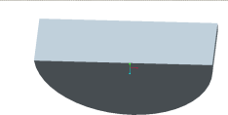





CAD Modeling Approach
Protrusion Extrude
Operation or feature
Protrusion Extrude
Protrusion Extrude
Procedural model
Protrusion Cut
Protrusion Cut
Explicit model
(B-rep)
Boundary evaluation
Protrusion Cut

Slide 4
Modeling Approaches
 | Explicit modeling | Procedural modeling
Representation | B-rep | The sequence of operations (features) used in constructing the model
Access to geometric information | Easy | Difficult
Editability | Difficult | Easy
Purpose | Engineering analysis, visualization | Engineering design change, design optimization
Commercial CAD systems support a mixture of two modeling approaches

Slide 5


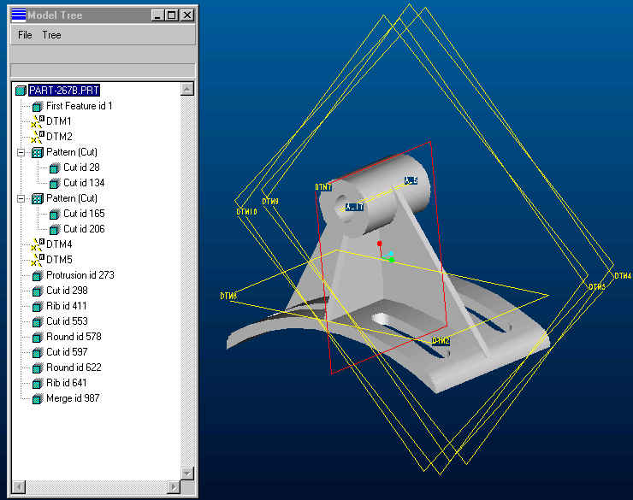
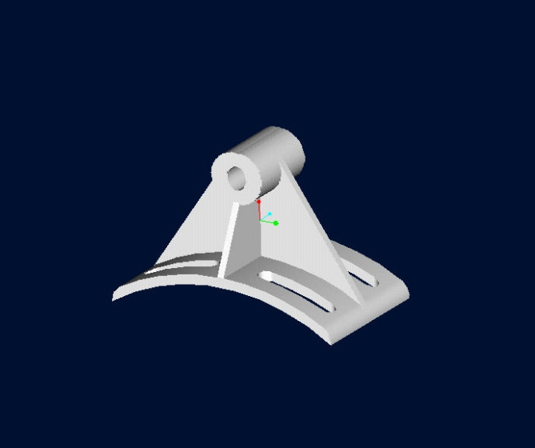
Example: As-Is
Intelligent Model
(Procedural Model)
Dumb Model
(B-rep Model)
T
T=4.1*W
W
Current
STEP
File
  Lost of design intents (feature, constraints, parametric information)
* From slide file, PDES, Inc

Slide 6

Example: To-Be
Intelligent Model
(Procedural Model)
Intelligent Model
(Procedural Model)
T
T=4.1*W
Feature
and
Parametric
Information
T
T=4.1*W
W
W
Final goal
  Feature-based or history-based exchange
* From slide file, PDES, Inc

Slide 7
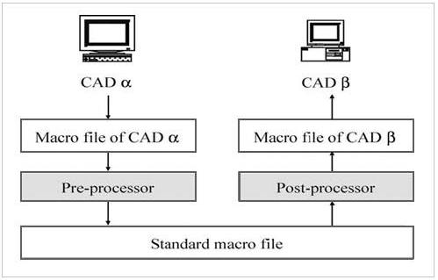
Macro-Parametrics Approach(MPA)
MPA is a methodology of exchange of CAD model data between CAD systems using macro file
Macro file contains the modeling operation history of each commercial CAD system
http://www.macro-parametrics.org
Pro/E
CATIA
UG
common
set
Neutral Macro File
Inventor
SolidWorks

Slide 8
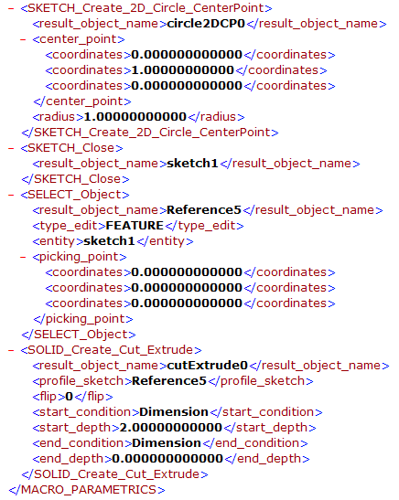
XML Macro File
CAD model
XML macro file

Slide 9













Implementation Team at KAIST
M
A
3ds Max
Abaqus
RapidForm
-
Post
I. Song
G. Cho
A
M
UG
TransCAD
S. Shin
J. Li
CATIA
H. Lee
I. Kim
H. Cho
M
A
UG Macro
Inventor
Persistent
Naming
(B.C. Kim)
D. Kim
Persistent
Naming
I. Song
H. Kim
A
M
Pro/E
Tribon/PDMS
S. Lee
-
M
AVEVA
A
A
J. Li
SKETCH
Microstation
SolidWorks
-
J. Hwang
M
Y. Kang
X3D
P. Singh

Slide 10
CAD Modeling & Exchange
Polygonal Representation (Mesh)
X3D
Explicit model
Final shape
Others
Features
MPA
Procedural model
Procedure
Modeling Commands
Constraints
Notes:
화살표 방향 procedural 은 양방향

Slide 11
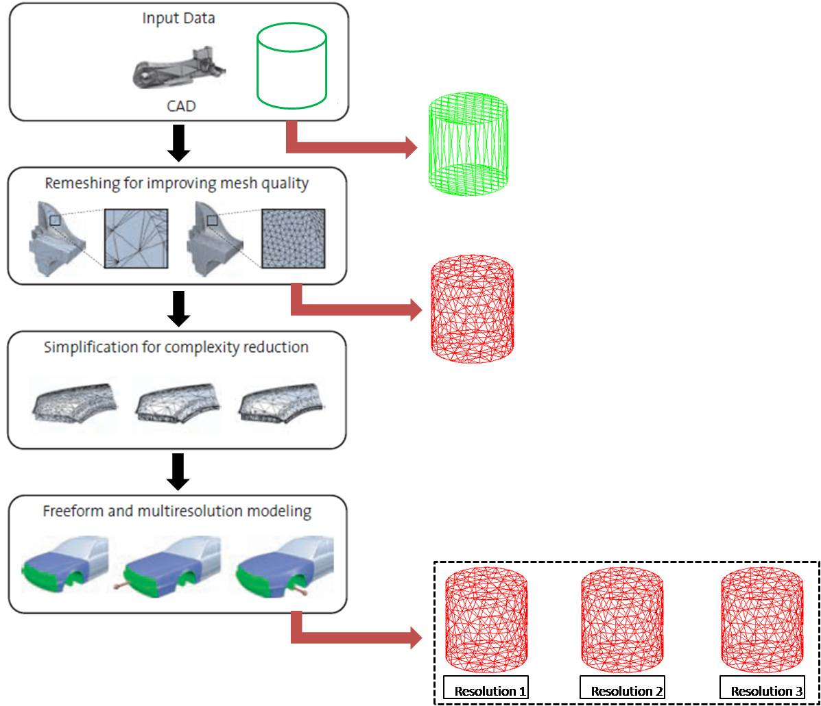
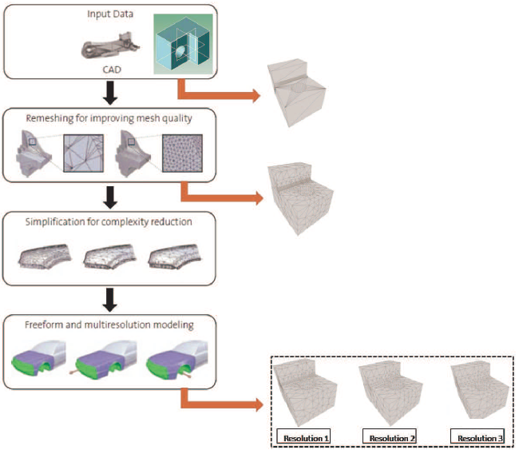
Mesh Processing Pipeline
Mesh Processing Pipeline modified from Mario Botsch(2006)*
Phase 1. Export Facet data from ACIS kernel
Phase 2. Get the high resolution mesh using TetGen
Phase 3. Reduce mesh for getting multi-resolution using MeshLab
Facet
High Resolution Mesh
Multi-Resolution Mesh
* Mario Botsch, Mark Pauly, Christian Rossl, Stephan Bischoff, Leif Kobbelt. “Geometric
Modeling Based on Triangle Meshes”, EUROGRAPHICS 2006 Tutorials, Vienna, Austria,
2006.

Slide 12
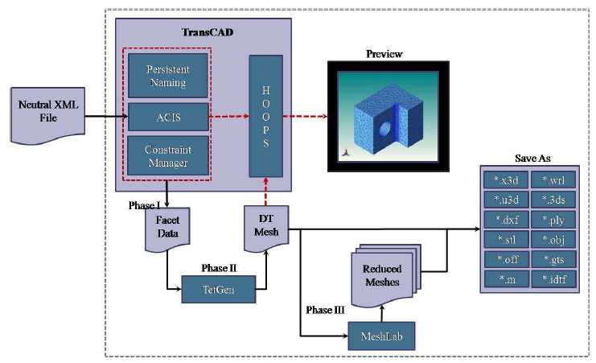
X3D Translation Scenario
DT: Delaunay Triangulated

Slide 13
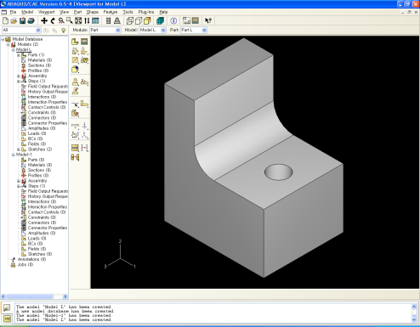
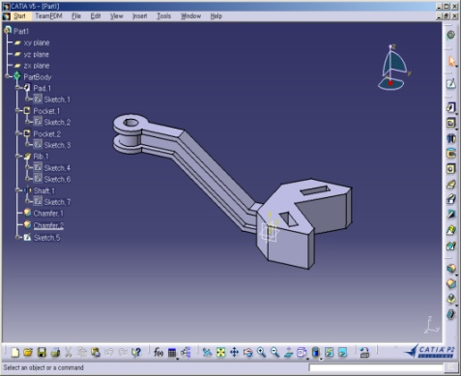
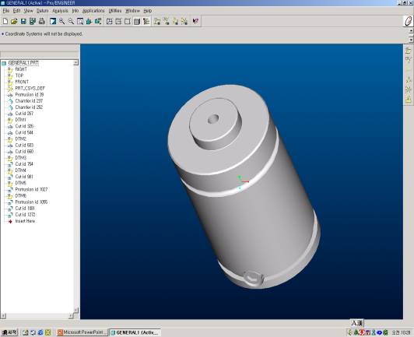
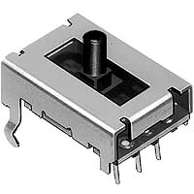
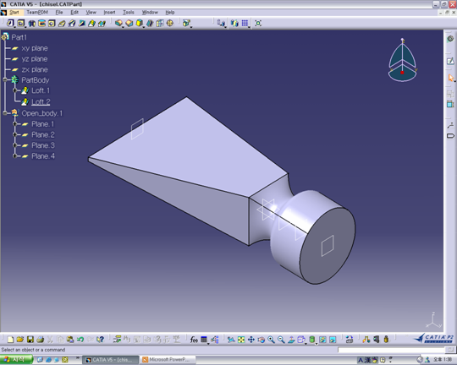
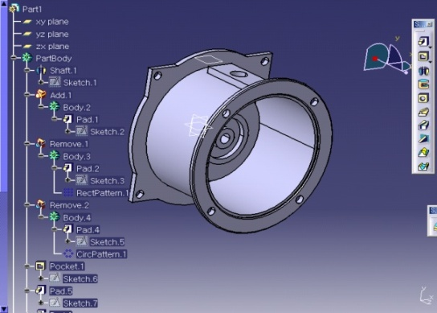
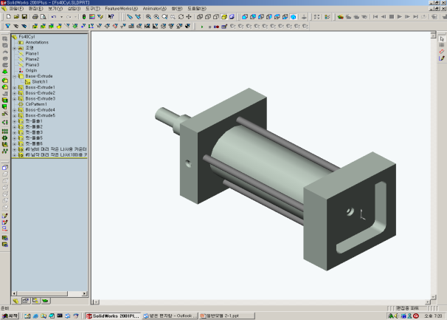
Test Cases Set I (KAIST)
K1: L-Block
K2: Y-Model
K3: Gas Spring
K4: Linear Sensor
K5: Engine Air-Filter Housing
K6: Pneumatics Cylinder
K7: Chisel

Slide 14
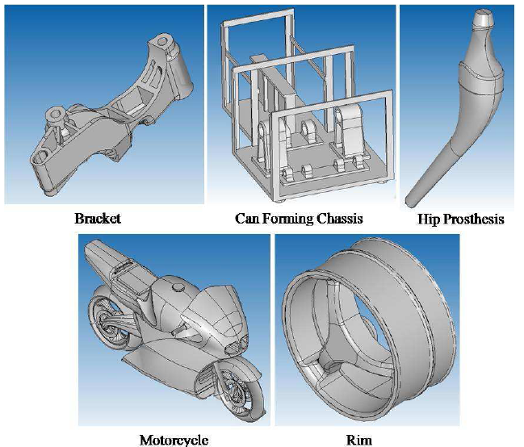
Test Cases Set II
(ACIS models with complex surfaces)

Slide 15
Experiments

Slide 16
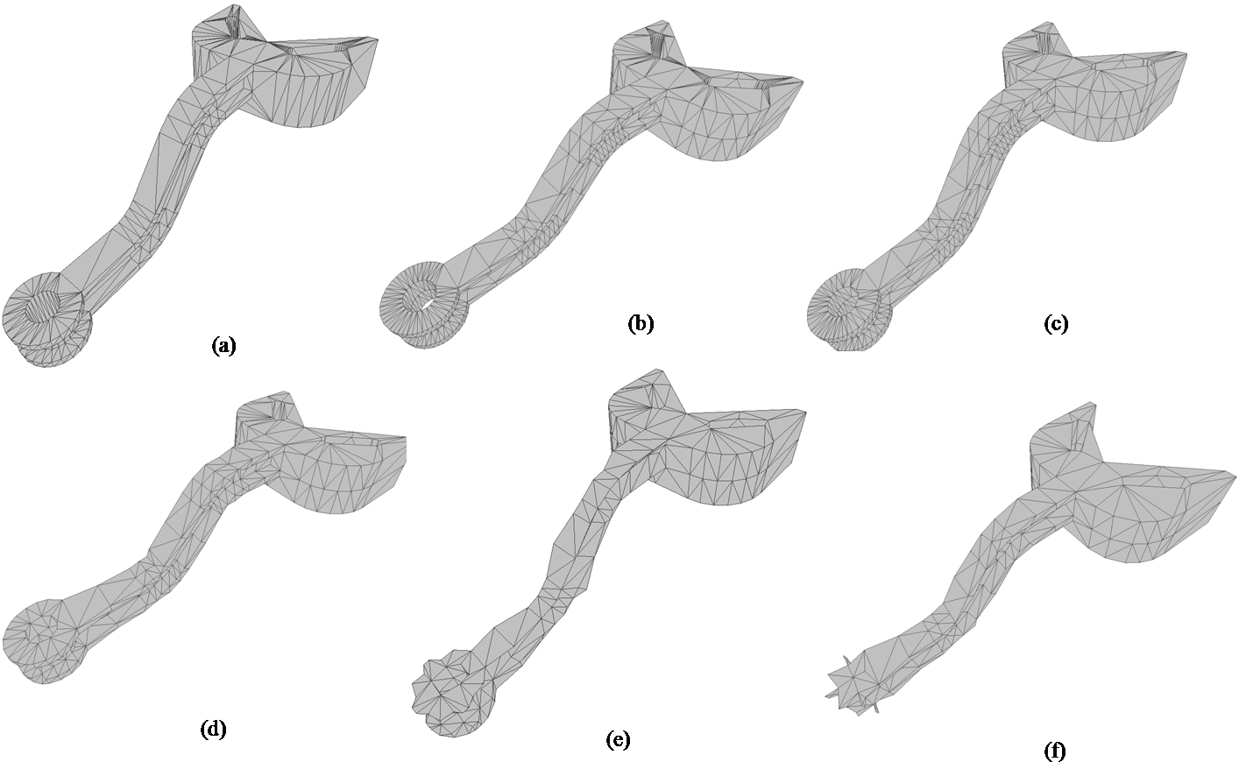
Test Case : Y-model (KAIST)
Y-model (KAIST) after (a) Phase I (b) Phase II (c), (d), (e), (f) Phase III

Slide 17
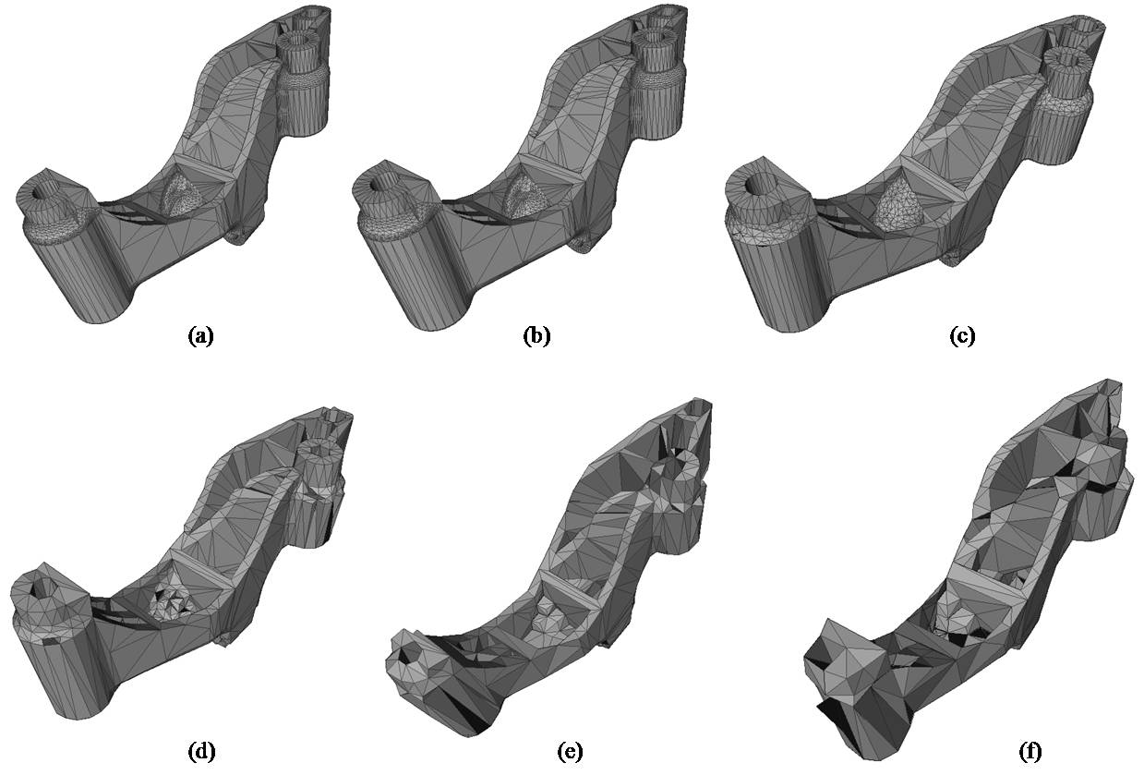
Test Case : Bracket (ACIS model)
Bracket (ACIS) after (a) Phase I (b) Phase II (c), (d), (e), (f) Phase III

Slide 18
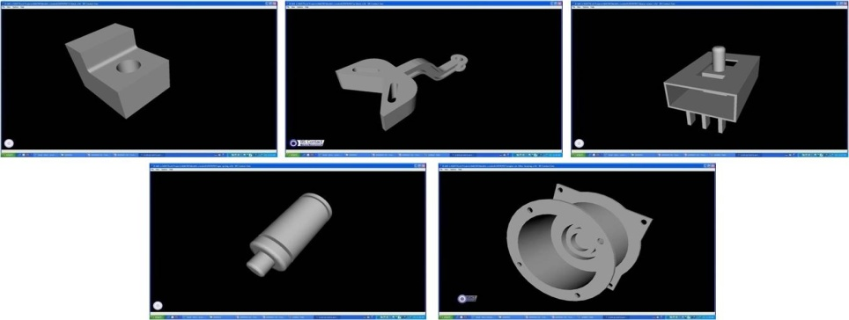
Test Cases Set I (KAIST)
High Resolution models after Phase II
Notes:
앞이랑 같게 통일 제목

Slide 19
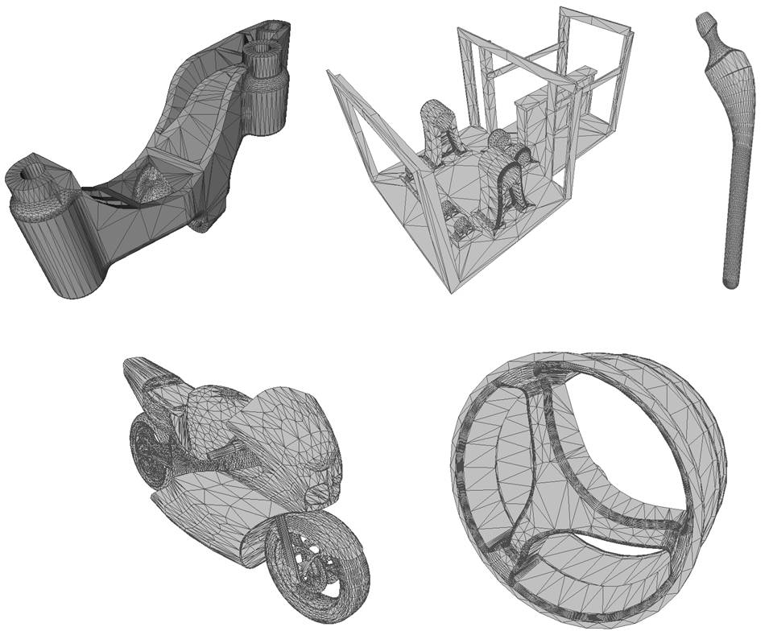
Test Cases Set II
(ACIS models with complex surfaces)
High Resolution models after Phase II

Slide 20
Conclusion
CAD translation to X3D using Macro-Parametric Approach
The CAD models of several commercial CAD systems can be transfer to X3D
If X3D can contain history information in the future, it is possible to translate CAD to X3D with history information also, using Macro-Parametrics Approach

Slide 21
Resources for further Information
www.macro-parametrics.org
www.tetgen.berlios.de
www.meshlab.org
W3C member resources on www.web3d.org
  “Members only Wiki” → X3D CAD Working Group
  “Documents” → CAD → Macro

Slide 22
Thank You

Slide 23
References
Guk-Heon Choi, Duhwan Mun, Soonhung Han. Exchange of CAD Part Models Based on the Macro-Parametric Approach. International Journal of CAD/CAM, Vol. 2, No. 1, pp. 13~21, 2002.
P.Cignoni, C. Montani and R. Scopigno. A Comparison of Mesh Simplification Algorithms. Computer & Graphics, Vol. 22, No. 1, pp. 37-54, 1998.
L. Kobbelt, S. Campagna, H.P. Siedel. A General Framework for Mesh Decimation. Computer Science Department, University of Erlangen-Nurnberg.
William J. Schroeder et al, Kok Lim et al. Decimation of Triangle Meshes & Model Simplification Using Vertex-Clustering.
J.Y.H. Fuha, W.D. Lib. Advances in collaborative CAD: the-state-of-the art.
www.macro-parametrics.org
www.tetgen.berlios.de
www.meshlab.org
ACIS Models from: http://www.opencascade.org/showroom/shapegallery/gal5/

Slide 24
References
10. Steven J. Owen. “A Survey of Unstructured Mesh Generation Technology”. ANSYS Inc., Canonsburg, PA.
11. Jonathan Richard Shewchuk. “Triangle: Engineering a 2D Quality Mesh Generator and Delaunay Triangulator”. School of Computer Science, Carnegie Mellon University.
12. Steven J. Owen, David R. White, Timothy J. Tautges. “FACET-BASED SURFACES FOR 3D MESH GENERATION”.
13. A. Ciampalini, P. Cignoni, C. Montani, R. Scopigno. Multiresolution decimation based on global error. The Visual Computer (1997)
14. Leila De Floriani and Paola Magillo. Multiresolution Mesh Representation: Models and Data Structures.
15. P. Alliez, G. Ucelli, C. Gotsman, and M. Attene. Recent advances in remeshing of surfaces. State-of-the-art report, 2005.

Slide 25
Appendix

Slide 26
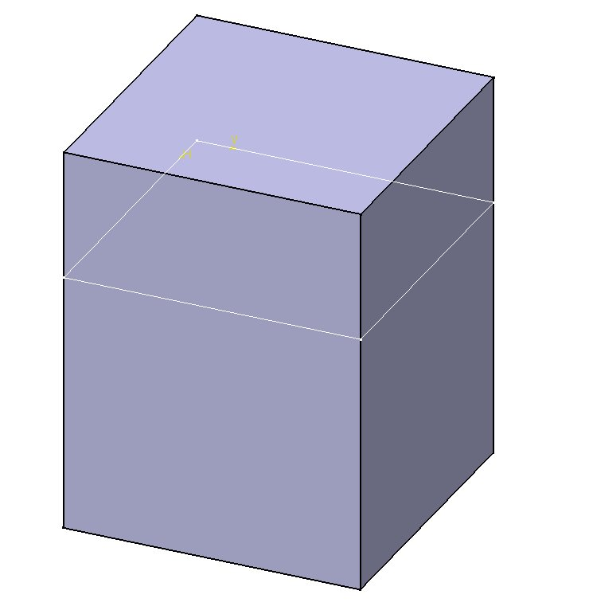
Neutral Modeling Command
ENTITY SOLID_Create_Protrusion_Extrude;
result_object_name : STRING;
profile_sketch : STRING;
flip : BOOLEAN;
start_condition : end_type;
start_depth : length_measure;
end_condition : end_type;
end_depth : length_measure;
END_ENTITY;
profile_sketch
start_condition
start_depth
end_condition
end_depth

Slide 27
Classification of Neutral Modeling Commands
 | No. of CC | No. of NCC | Sum
Sketch commands | 30 | 27 | 57
Surface commands | 17 | 6 | 23
Solid commands | 22 | 18 | 40
Constraint commands | 21 | 3 | 24
 | 90 | 54 | 144
CC: Core commands
NCC: Non-core commands

Slide 28
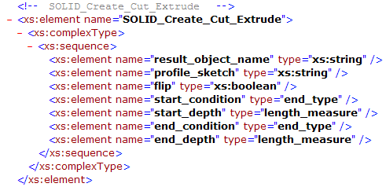
XML Schema
Neutral macro schema
XML macro schema
ENTITY SOLID_Create_Protrusion_Extrude;
result_object_name : STRING;
profile_sketch : STRING;
flip : BOOLEAN;
start_condition : end_type;
start_depth : length_measure;
end_condition : end_type;
end_depth : length_measure;
END_ENTITY;

Slide 29
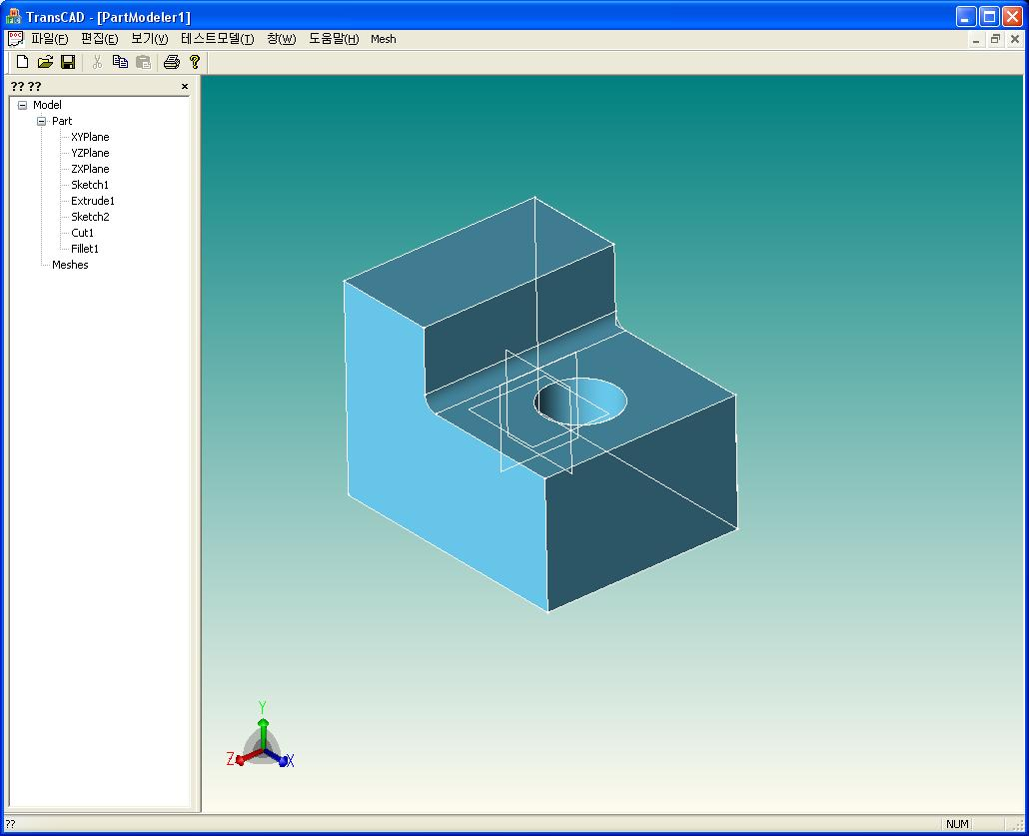
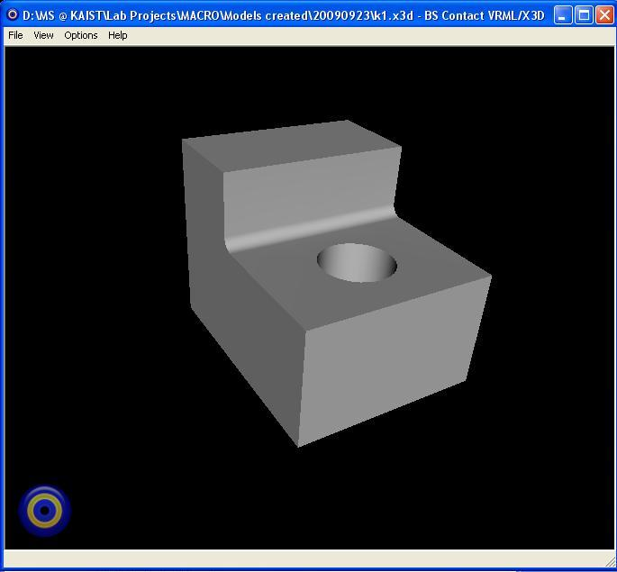
L-Block (K1)
Neutral XML
X3D

Slide 30
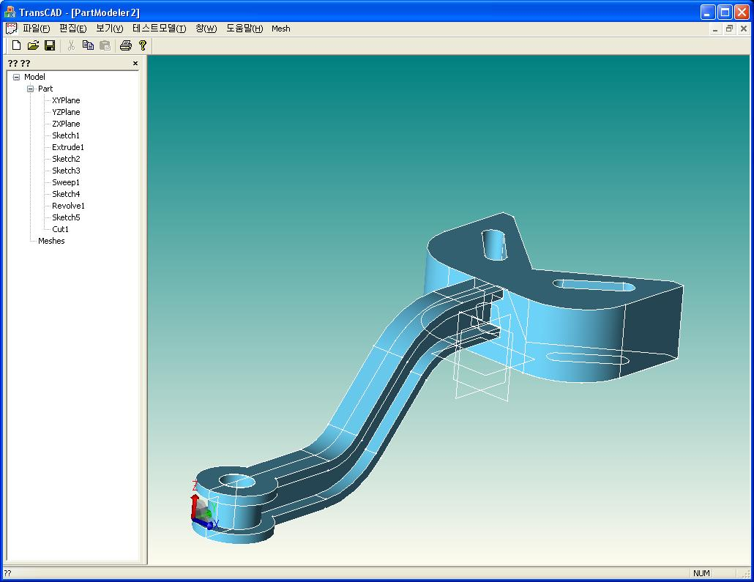
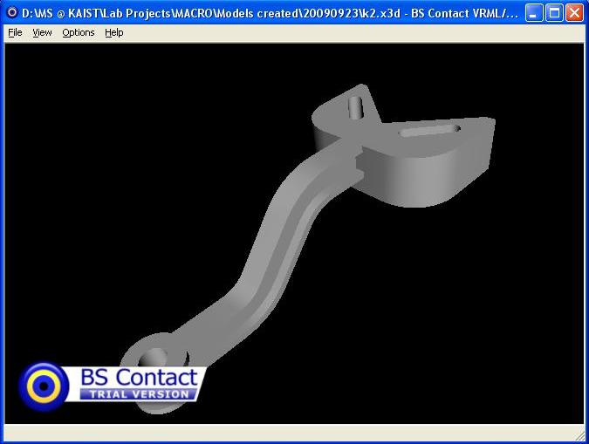
Y-model (K2)
Neutral XML
X3D

Slide 31
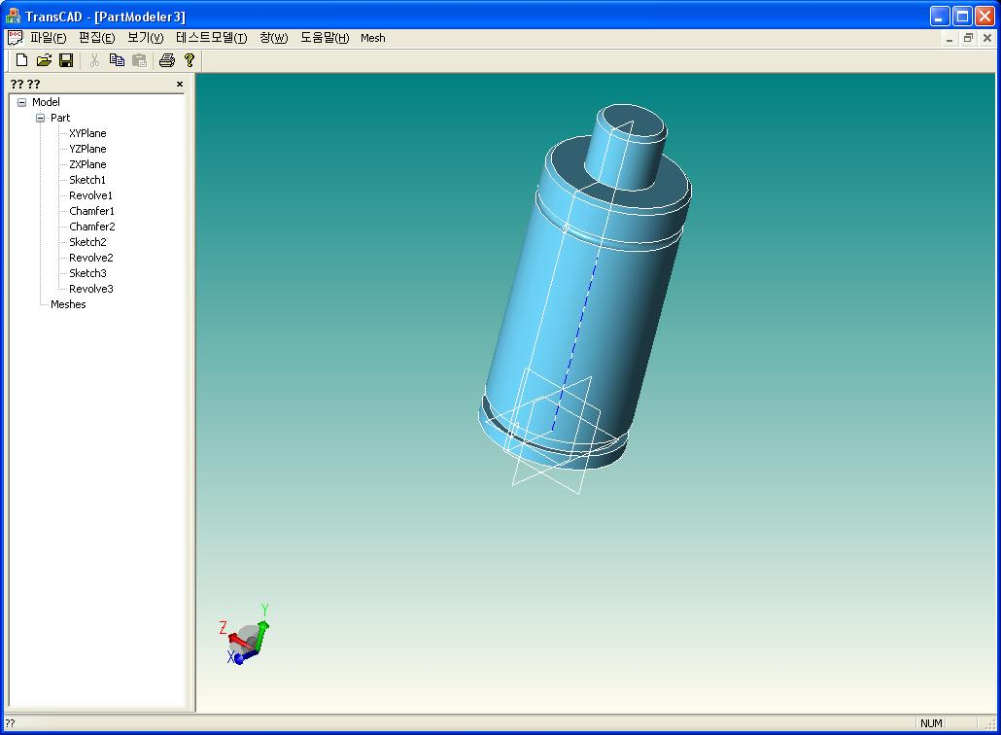
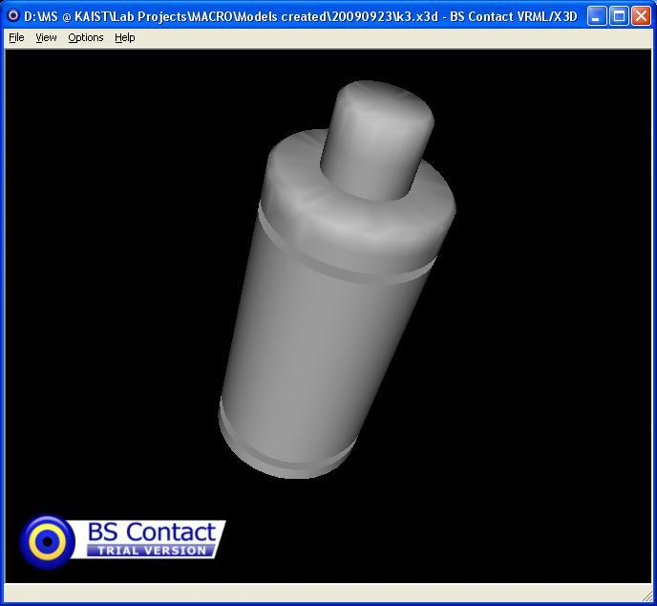
Gas Spring (K3)
Neutral XML
X3D

Slide 32
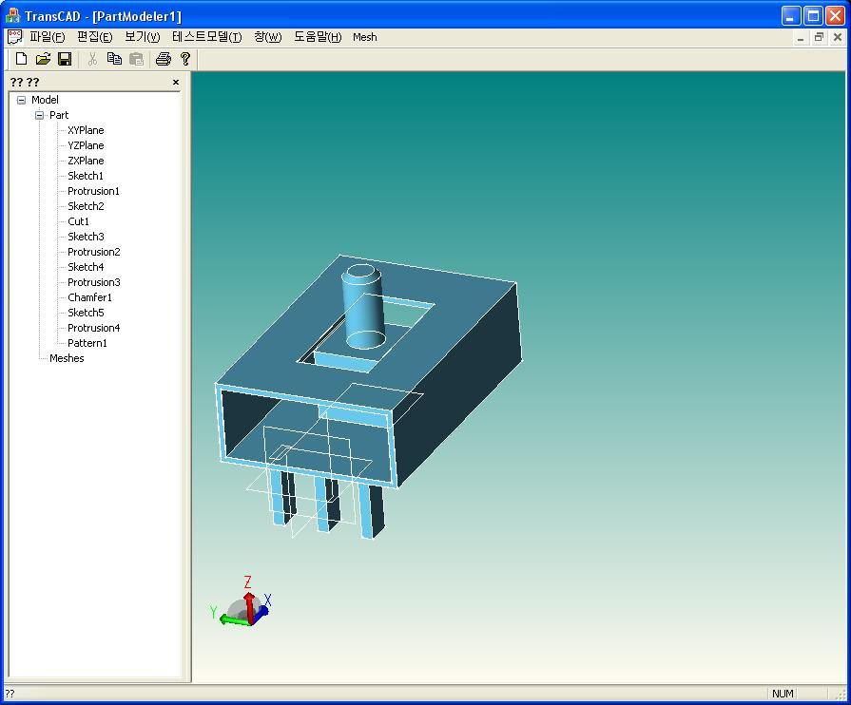
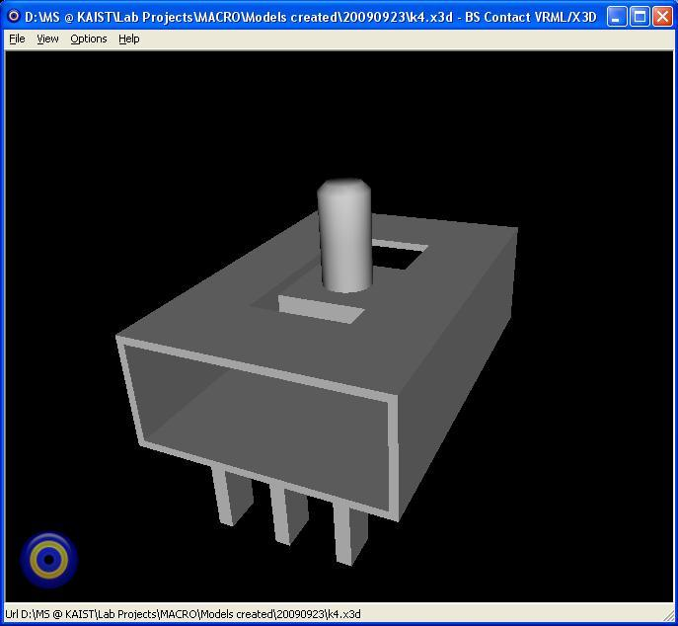
Linear Sensor (K4)
Neutral XML
X3D

Slide 33
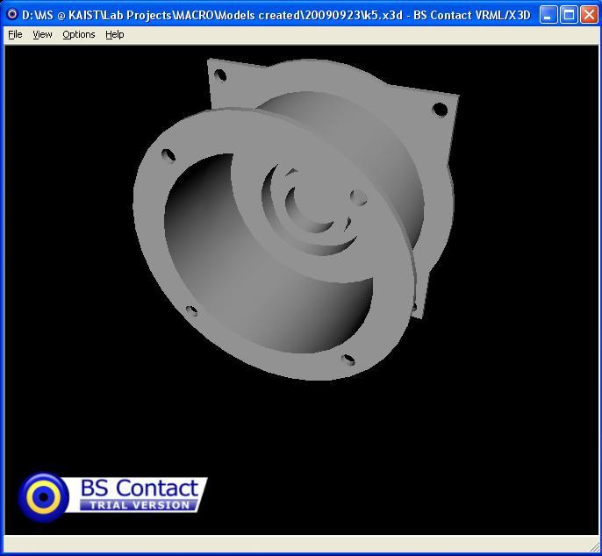
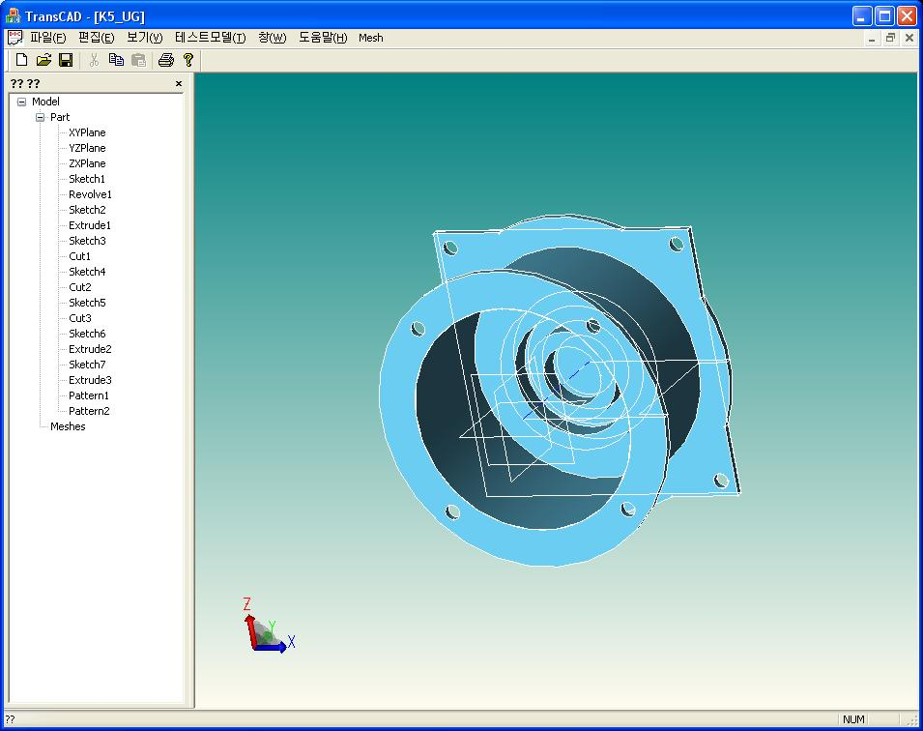
Engine Air-Filter Housing (K5)
X3D
Neutral XML

Slide 34
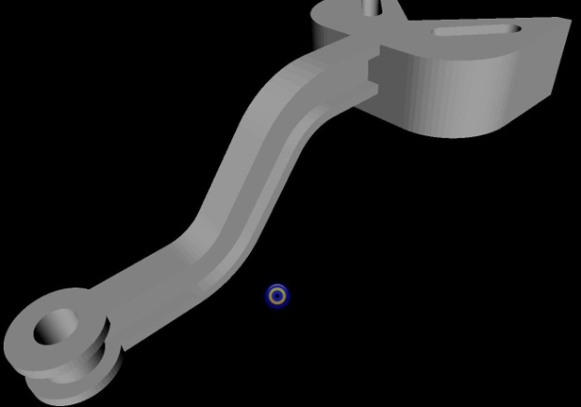
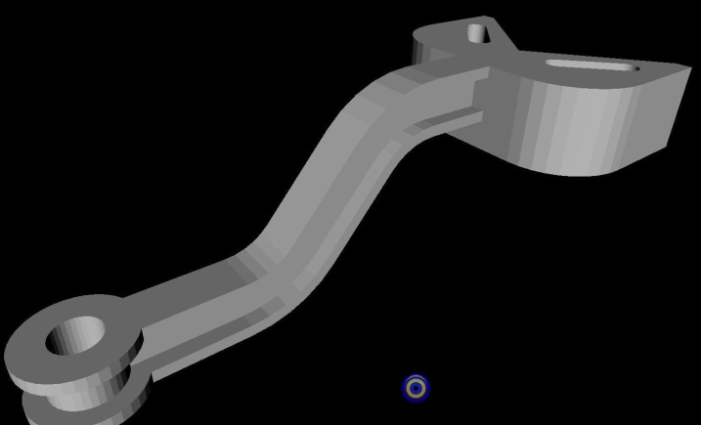
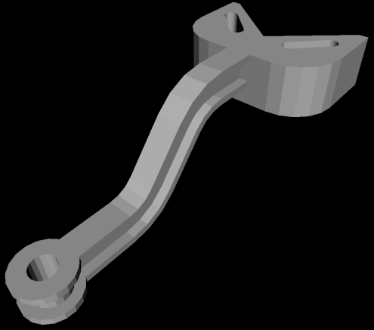
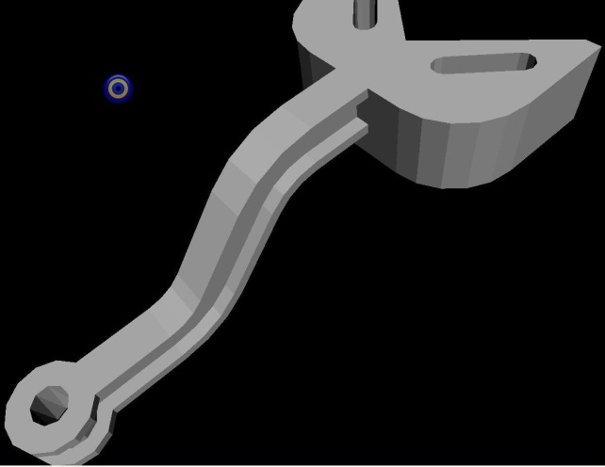
Effect of Normal Tolerance on Faceting
NT = 5
NT = 10
NT = 20
NT = 40

